Slide 1
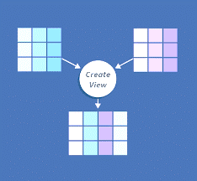
Views -SQL
K Krishna priya
Cse department,iiit nuzvid

Slide 2
What is a View in DBMS?
Writing Complex queries and Securing Database access is very challenging for any Database Developer and Database Administrator.
Sometimes SQL queries get very complicated by joins, Group By clauses, and other referential dependencies, So those Types of queries can be simplified to proxy data or virtual data which simplifies the queries.
Also, Security challenges can also be overcome by giving restricted access to only the data user needs. Let's take an example to understand this better.
Suppose, the user needs only 2 columns of data, so instead of giving him access to the whole table in the database, the Database Administrator can easily create a virtual table of 2 columns that the user needs using the views.
This will not give full access to the table and the user is only seeing the projection of only 2 columns and it keeps the database secure.

Slide 3
Views in DBMS
A view is a table whose rows are not explicitly stored, a view is a virtual table based on the result-set of an SQL statement.
A view can contain all rows of a table or select rows from a table. A view can be created from one or many tables which depends on the written SQL query to create a view.
We can visualize views in DBMS as some kind of virtual tables that are like projections of data fields from original tables and are not actual tables of the database. We can extract some specific data from multiple tables based on our needs using views.
Views act as a proxy or virtual table created from the original table.
Views simplify SQL queries and allow secure access to underlying tables.

Slide 4
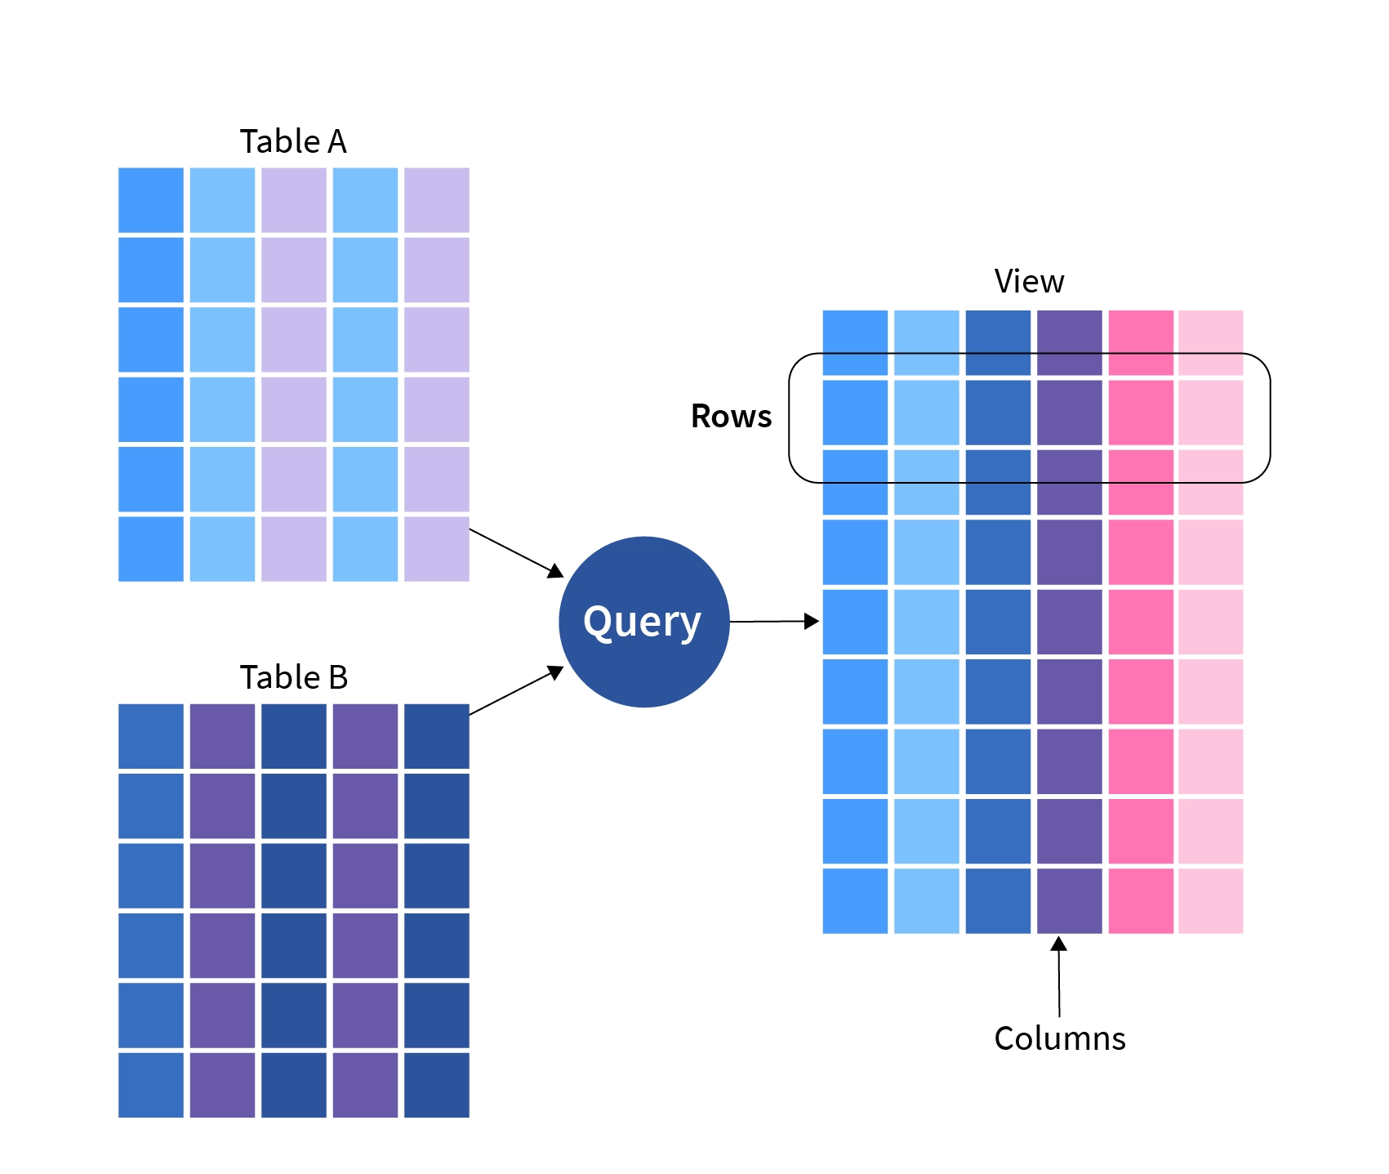
Views in DBMS can be visualized as virtual tables that are formed by original tables from the database.
As you can see from the above image, we can extract data columns from more than one table by running queries on the data tables.
Views contain only the definition of the view data in the data dictionary, not the actual data.

Slide 5
The view has two primary purposes:
Simplifying complex SQL queries.
Restricting users from accessing sensitive data.

Slide 6
Advantages of View over database tables
Using Views, we can join multiple tables into a single virtual table.
Views hide data complexity.
In the database, views take less space than tables for storing data because the database contains only the view definition.
Views indicate the subset of that data, which is contained in the tables of the database.

Slide 7
Creating Views
Database views are created using the CREATE VIEW statement. Views can be created from a single table, multiple tables or another view.
To create a view, a user must have the appropriate system privilege according to the specific implementation.
The view can be created by using the CREATE VIEW statement, Views can be simple or complex depending on their usage.
CREATE VIEW view_name AS
SELECT column1, column2, ...
FROM table_name
WHERE condition;
CREATE VIEW Students_CSE AS
SELECT Roll_no,Name
FROM Students
WHERE Branch = 'CSE';

Slide 8
Employee Table:
This table contains details of employees in a particular company and has data fields such as EmpID, EmpName, Address, Contact. We have added 6 records of employees for our purpose.
EmpID | EmpName | Address | Contact
1 | Alex | London | 05-12421969
2 | Adolf | San Francisco | 01-12584365
3 | Aryan | Delhi | 91-9672367287
4 | Bhuvan | Hyderabad | 91-9983288383
5 | Carol | New York | 01-18928992
6 | Steve | California | 01-13783282

Slide 9
EmpRole Table:
This table contains details of employees' roles in a particular company and has data fields as EmpID, Role, Dept. We have stored all the records particular to the EmpID of each employee.
EmpID | Role | Dept
1 | Intern | Engineering
2 | Trainee | IT
3 | Executive | HR
4 | SDE-1 | Engineering
5 | SDE-2 | Engineering
6 | Technical Architect | Engineering

Slide 10
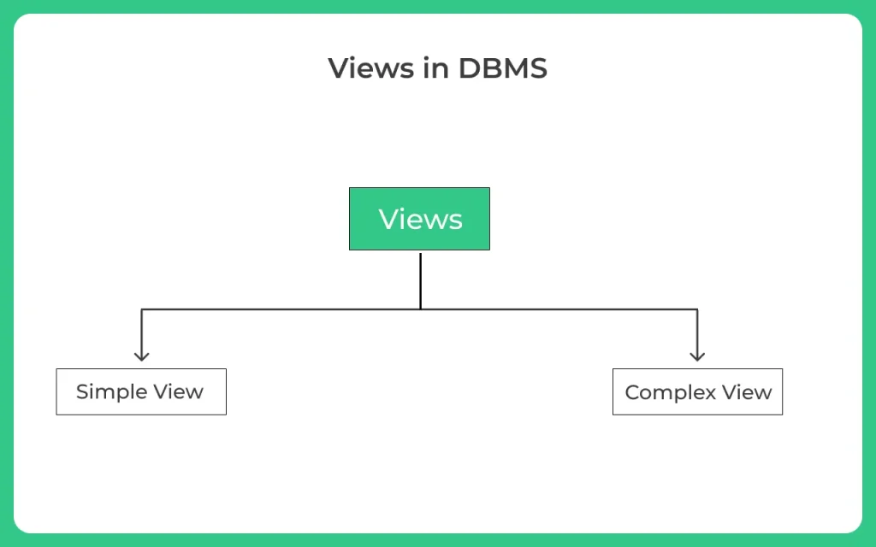

Slide 11
Creating a Simple View
Simple view is the view that is made from a single table, It takes only one table and just the conditions, It also does not take any inbuilt SQL functions like AVG(), MIN(), MAX() etc, or GROUP BY clause.
While creating a simple view, we are not creating an actual table, we are just projecting the data from the original table to create a view table.
Example 1: In this example, we are creating a view table from Employee Table for getting the EmpID and EmpName. So the query will be:
CREATE VIEW EmpView1 AS EmpID , EmpName from Employee;

Slide 12
Now to see the data in the EmpView1 view created by us, We have to simply use the SELECT statement.
Select *from EmpView1;
Output:
The view table EmpView1 that we have created from Employee Table contains EmpID and EmpName as its data fields.
EmpID | EmpName
1 | Alex
2 | Adolf
3 | Aryan
4 | Bhuvan
5 | Carol
6 | Steve

Slide 13
Example 2: In this example, we are creating a view table from EmpRole Table for getting the EmpID and Dept for employees having EmpIDs less than 4. So the query will be:
Now to see the data in the EmpView2 view created by us, We have to simply use the SELECT statement.
Select * from EmpView2;
Output:
The view table EmpView2 that we have
created from EmpRole Table contains
EmpID and Dept as its data fields.
Create View EmpView2 As select EmpID ,Dept from EmpRole
Where EmpID<4;
EmpID | Dept
1 | Engineering
2 | IT
3 | HR

Slide 14
Creating a Complex View
The complex view is the view that is made from multiple tables, It takes multiple tables in which data is accessed using joins or cross products, It contains inbuilt SQL functions like AVG(), MIN(), MAX() etc, or GROUP BY clause.
So, whenever we need to access data from multiple tables we can make use of Complex Views.
Let's look at some examples for creating the complex view.
Example:
In this example, we are creating a view table using Employee Table and EmpDept table for getting the EmpName from the Employee table and Dept from EmpDept. So the query will be:
CREATE VIEW EmpView1 AS
SELECT Employee.EmpName, EmpRole.Dept
FROM Employee, EmpRole
WHERE Employee.EmpID = EmpRole.EmpID;

Slide 15
Output:
The view table that we have created from Employee Table and EmpRole Table contains EmpName and Dept as its data fields.
We can also use the cross-join to get our necessary data.
EmpName | Dept
Alex | Engineering
Adolf | IT
Aryan | HR
Bhuvan | Engineering
Carol | Engineering
Steve | Engineering

Slide 16
Updating a View
A view can be updated with the CREATE OR REPLACE VIEW statement.
Create or replace view statement is used to add or remove fields from existing views
Views are updated only if certain conditions are met otherwise if any one of the conditions are not met views will not be updated.
Criteria for View Updating
The select statement used in the create view statement should not include group by clause or order by clause
The select statement must not contain distinct keyword
A view should not be created from nested or Complex queries
A view should be created from a single table but if the view is created from more than one table then it is not allowed for updating

Slide 17
Syntax:
CREATE OR REPLACE VIEW view_name AS
SELECT column1,coulmn2,..
FROM table_name
WHERE condition;
The following SQL adds the "Mobile" column to the "Students_CSE" view:
Example:
CREATE OR REPLACE VIEW Students_CSE AS
SELECT Roll_no,Name,Mobile
FROM Students
WHERE Branch = 'CSE';
CREATE VIEW defines a view on a set of tables or views or both.
REPLACE VIEW redefines an existing view.
Fetch all the data from MarksView now as:
SELECT * FROM Students_CSE;

Slide 18
Manipulating Data in a View
Views can also be used to manipulate data in the scope of the view table only,
if the view is updatable, updating it will also update the base table or base tables from which the view is derived.
Any modifications you make to the view will also affect the base table(s).Updateable Views are views that allow for data manipulation but there are certain conditions needed to be taken care of while manipulating the data of the view:
The GROUP BY and ORDER BY clauses should not be included in the SELECT statement used to generate the view.
The DISTINCT keyword should not be used in the SELECT statement.
All NOT NULL values should be present in the View.
Nested or complex queries should not be used to construct the view.
A single table should be used to generate the view. We would not be able to update the view if it was constructed using several tables.
Manipulating data in a view includes inserting or deleting a row from the view table

Slide 19
Inserting a Row in a View
We can use insert into statement of SQL to insert a row in a view just like inserting a row in an ordinary table
Syntax:
INSERT view_name(column1, column2 , column3,..)
VALUES(value1, value2, value3..);
Example
INSERT INTO DetailsView(NAME, ADDRESS)
VALUES("Preity","Hyderabad");

Slide 20
Deleting a Row in a View
A row in a view can be deleted just like simply deleting rows from a Table using delete statement
But remember a row in a view can be deleted only if the row is actually deleted in the original table from which it is created
Syntax:
DELETE FROM view_name
WHERE condition;
Example
DELETE FROM DetailsView
WHERE NAME="Preity";

Slide 21
Dropping a View
In order to delete a view in a database, we can use the DROP VIEW statement.
DROP VIEW view_name;
DROP VIEW Students_CSE;

Slide 22
Limitations
Modifications: Not all views support INSERT, UPDATE, or DELETE operations. Complex multi-table views are generally read-only.
Performance: Hugely complex job for the database engine. That is because each time a view is referenced, the query used to define it, is rerun.

